Slide 1
CHAPTER 10
Physical Evidence and the Servicescape

Slide 2
Chapter Objectives
Explain the impact of physical evidence, with emphasis on the servicescape, customer perceptions, and experiences.
Illustrate differences in types of servicescapes, the roles played by the servicescape, and the implications for strategy.
Explain why the servicescape affects customer and employee behavior, using a framework based in marketing, organizational behavior, and environmental psychology.
Present elements of an effective physical evidence strategy.

Slide 3
Physical Evidence
Physical evidence are tangible cues that allow customers to evaluate the service before its purchase and to assess their satisfaction with the service during and after the experience.
This is helpful in closing customer Gap 2 (service standards and design gap).
This includes all elements of the organization’s physical facility as well as other forms of tangible communication (like signs).

Slide 4
Elements of Physical Evidence
Servicescape | Other Tangibles | Virtual
Facility exterior | Business cards | Web pages
Exterior design | Stationery | 360-degree videos
Signage | Billing statements | Virtual design
Parking | Reports | Drone footage
Landscape | Employee dress
Surrounding environment | Uniforms
Facility interior | Brochures
Interior design | Virtual servicescape
Equipment
Signage
Layout
Air quality/ temperature
Sound/ music/ scent/ lighting

Slide 5
The process of clearly identifying and managing all the various clues that customers use to form their impressions and feelings about the company.
Clue Management
Notes:
Including physical and tangible clues

Slide 6
Typology of Servicescapes
Servicescape Usage
Whom the servicescape design will affect? Customer, employees, partners, vendors?
Three types:
  Self-service: customer only, e.g., water park
  Interpersonal service: both customer and employee, e.g., hotel
  Remote service: employee only, e.g., telecom
Servicescape Complexity
Some environments are very simple while others are very complex.
Simple: lean environments (e.g., ATM)
Elaborate: complex environments (e.g., water park)

Slide 7
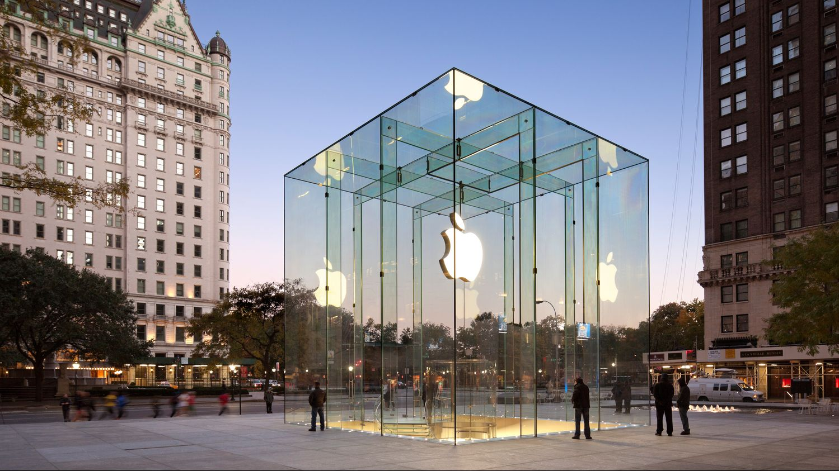
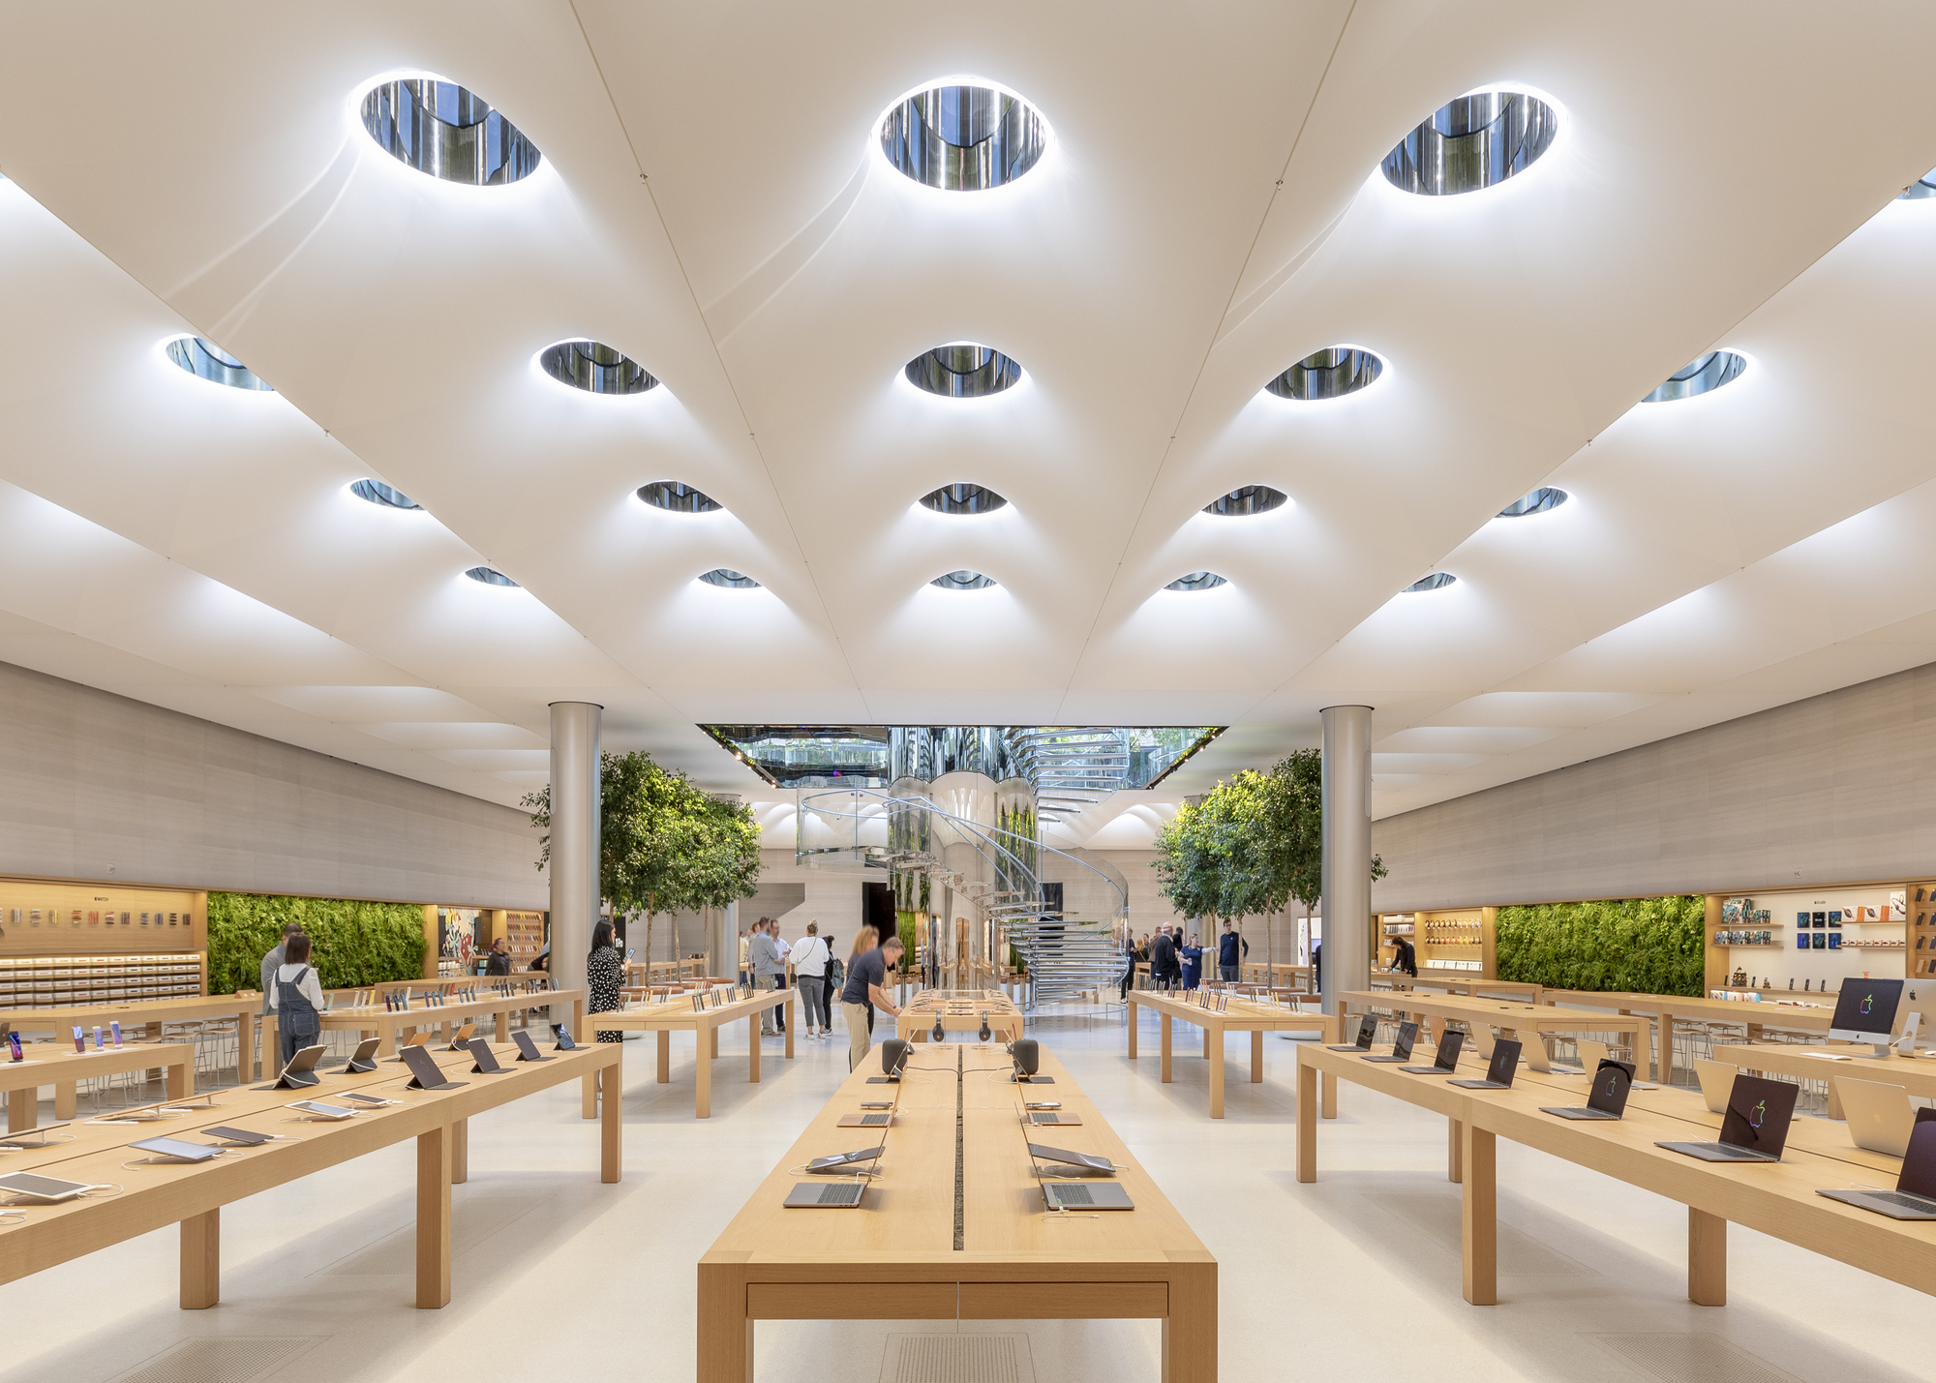
Servicescape Roles
Package: this “wraps” the service and convey to customers an external image of what is inside
Facilitator: a well-designed, functional facility can make the service a pleasurable experience for both customer and employee.

Slide 8

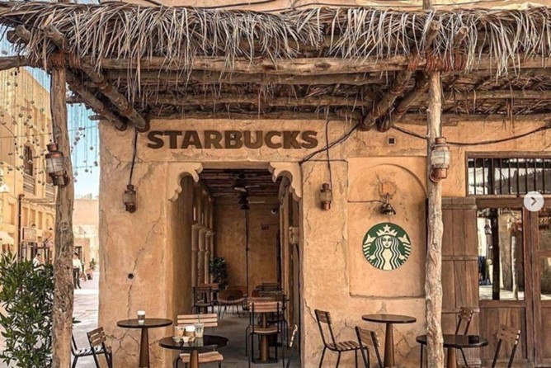
Servicescape Roles
Socializer: the design can aid in the socialization of employees and customers
Differentiator: can be used to reposition a firm and/or attract new market segments.

Slide 9
Guidelines for Physical Evidence Strategy
Recognize the strategic impact of physical evidence
Blueprint the physical evidence of service
Clarify strategic roles of the servicescape
Assess and identify physical evidence opportunities
Update and modernize the evidence
Work cross-functionally

